Slide 1


Our way…
GALAMTOR 2019
Andrei Kim

Slide 2

Target Audience
10 <~ AGE <~ 25

Slide 3
REFRESHING YOUR PLAYLIST
. . .
THE OLD WAY

Slide 4
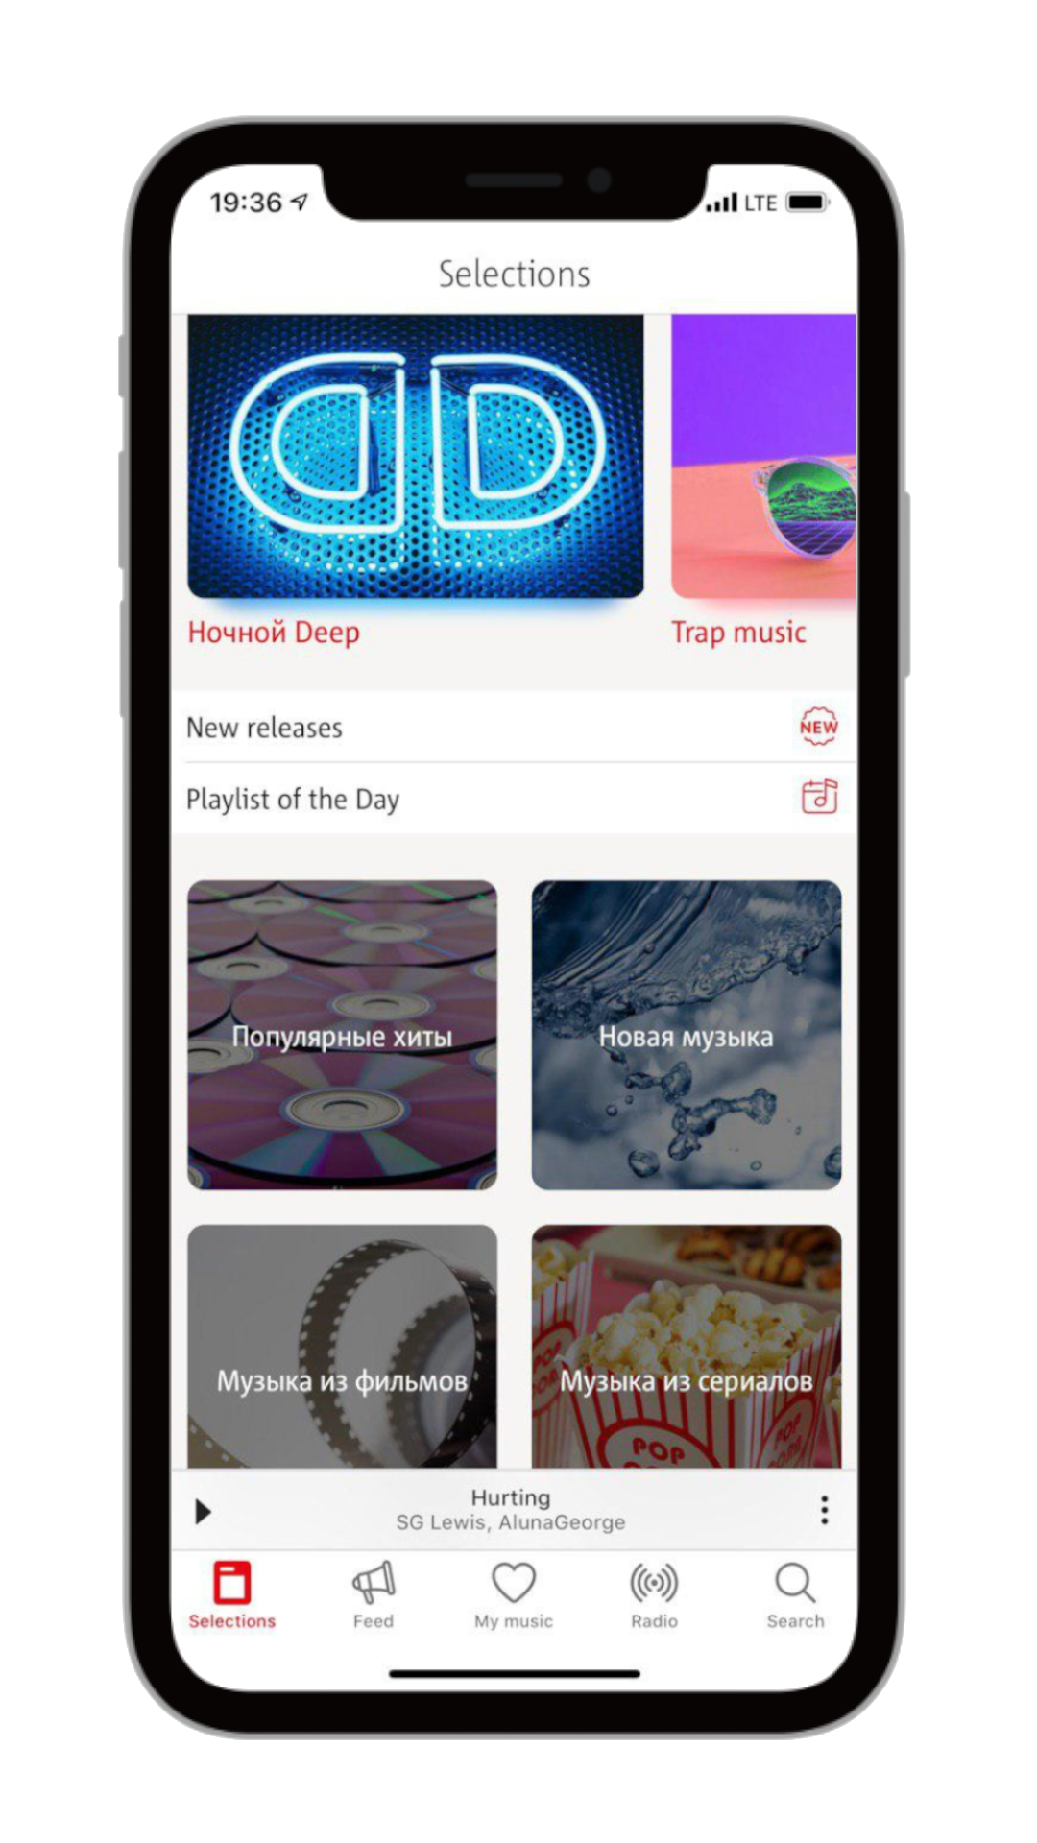
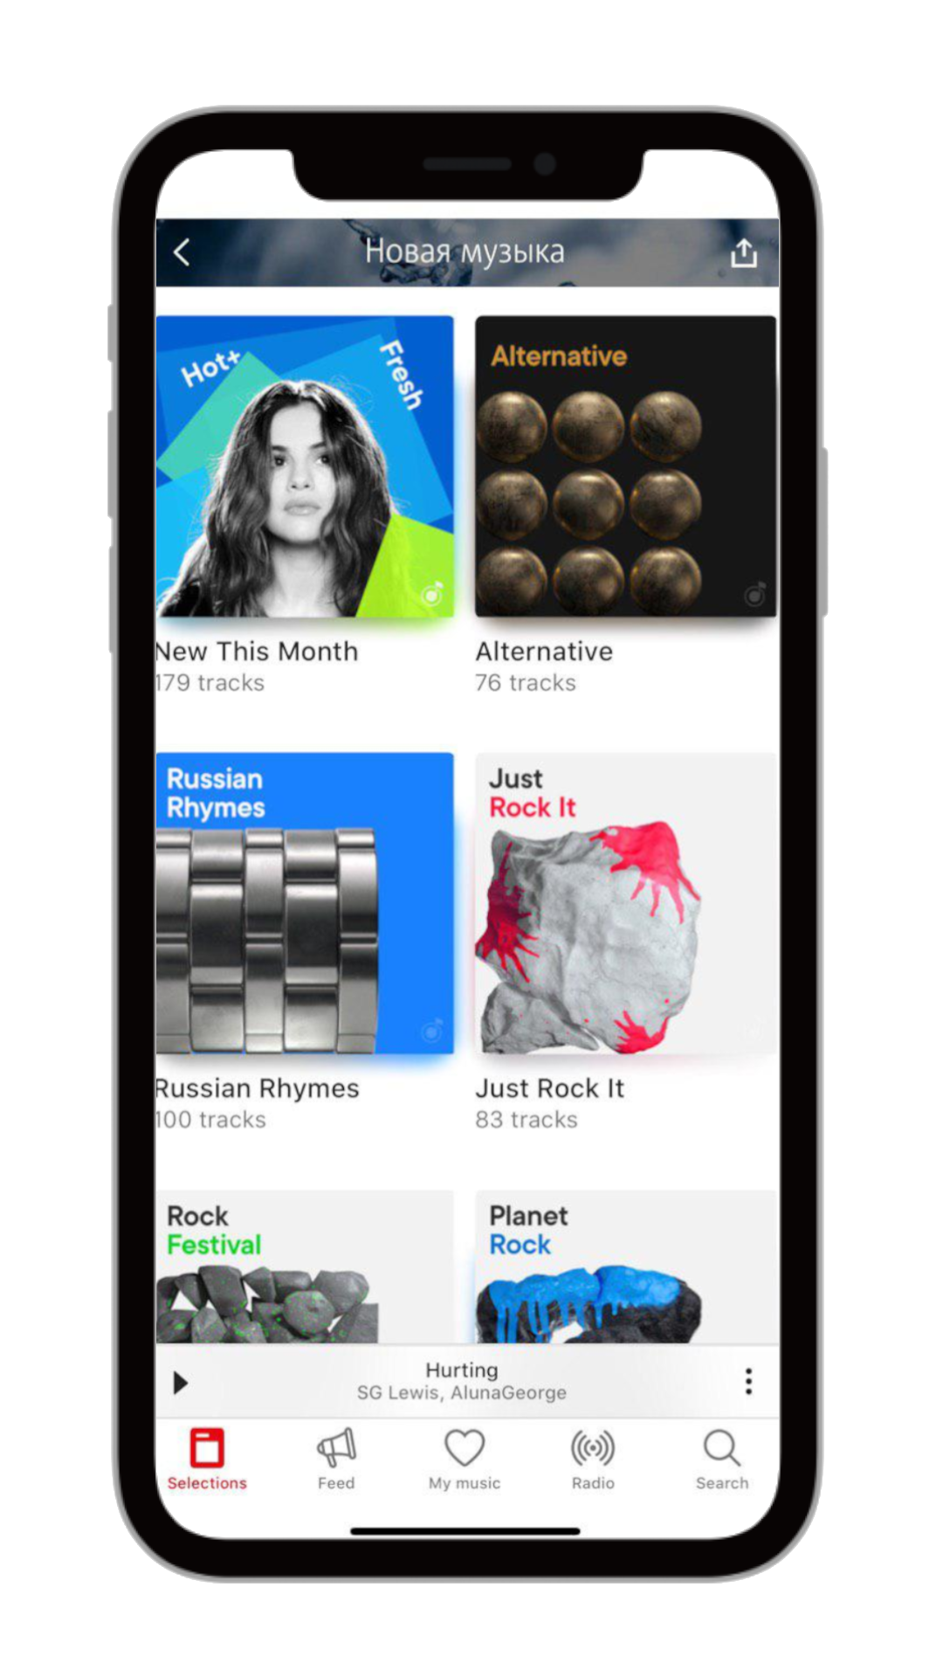
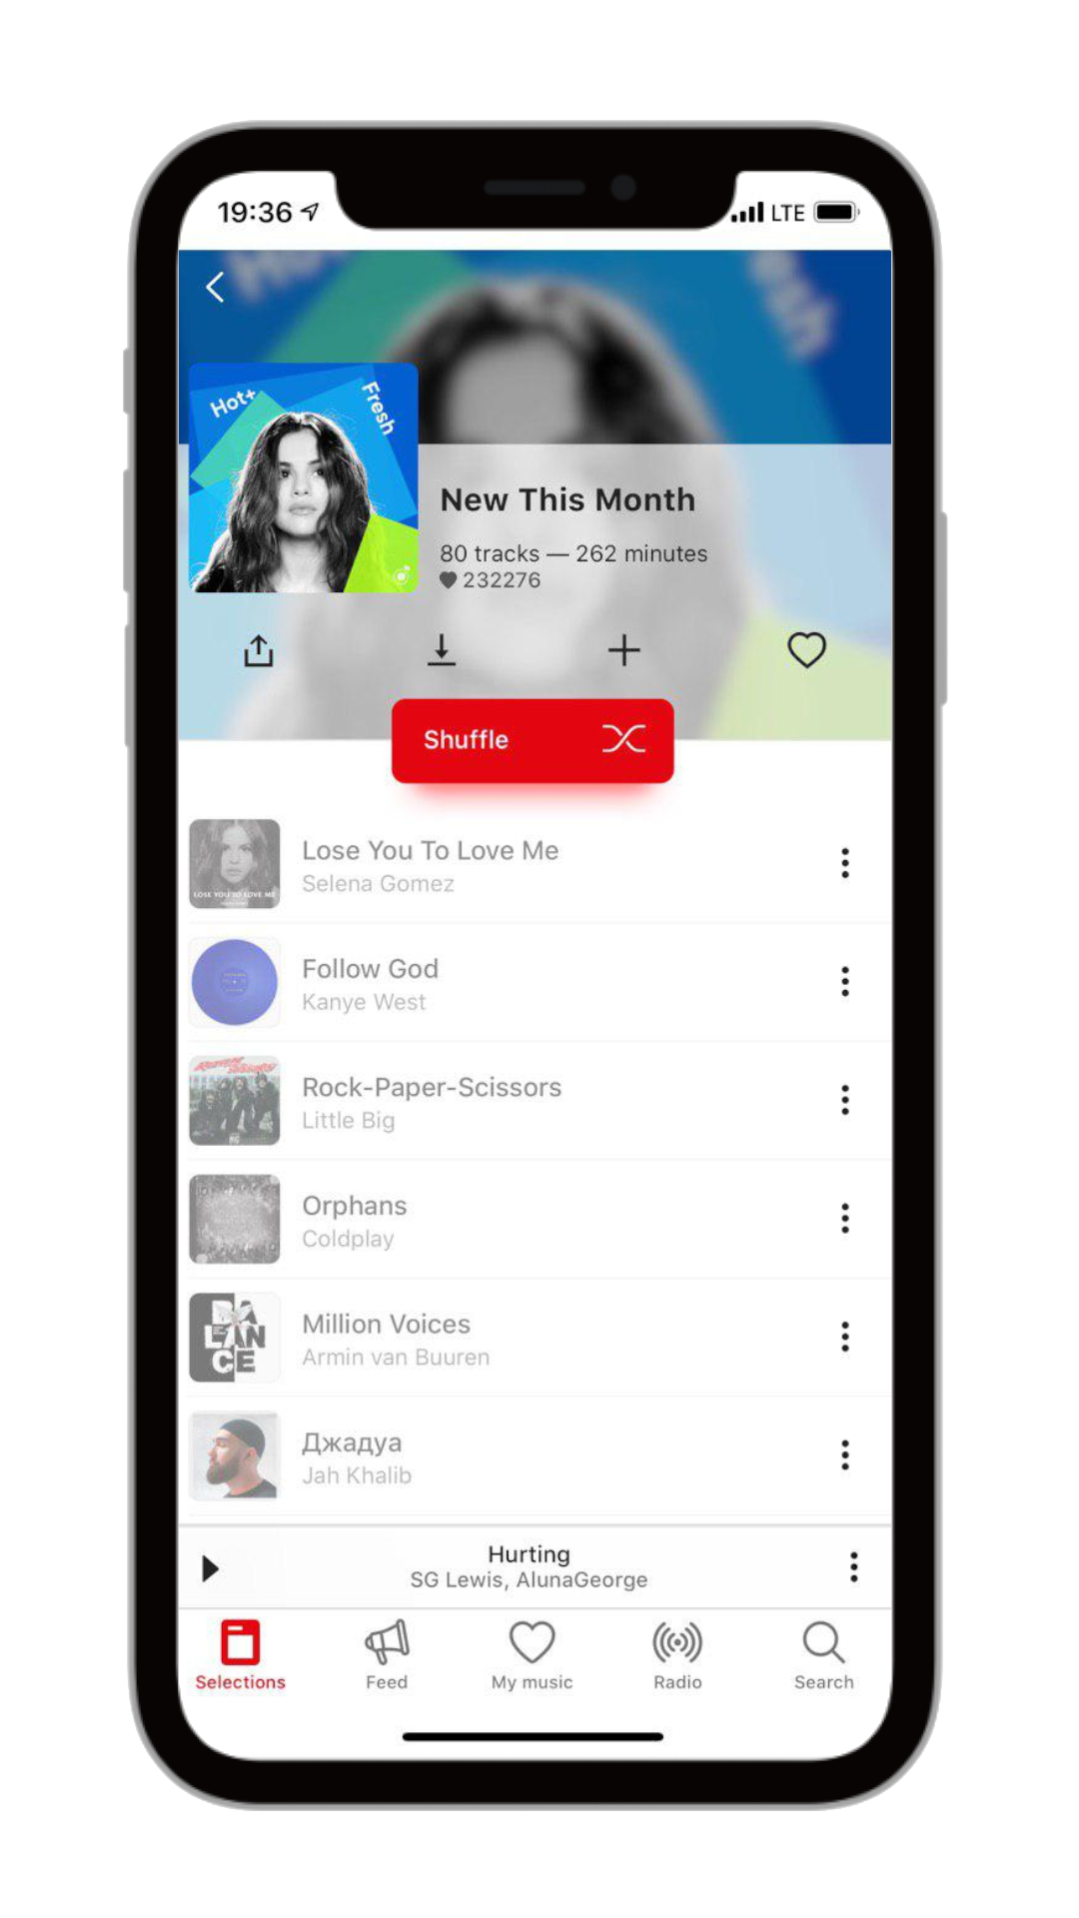
Andrei Kim

Slide 5
OUR WAY,
THE MODERN WAY.

Slide 6
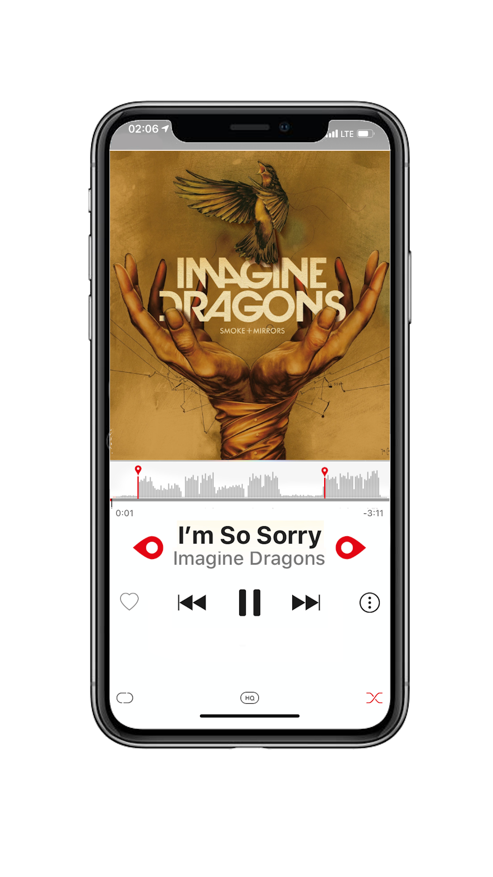
Andrei Kim

Slide 7


SPECTROGRAM
RAPID Amplitude GROWTH
Andrei Kim

Slide 8
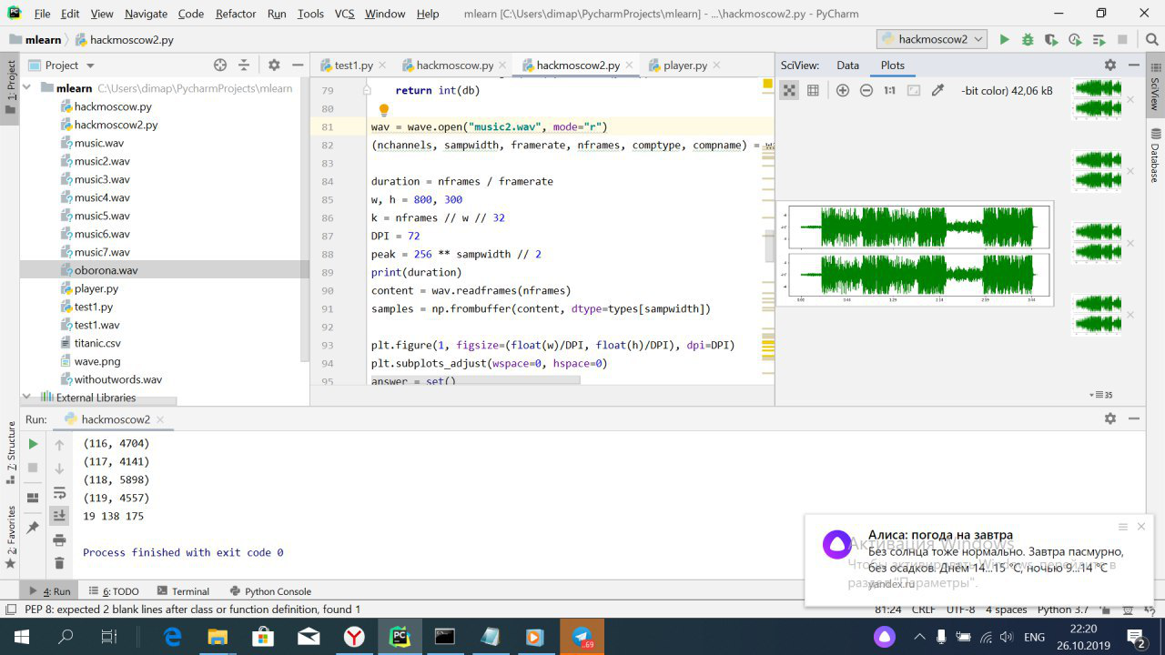



Slide 9
Andrei Kim

